Slide 1
Muhammad Faisal
Bug Tracker

Slide 2
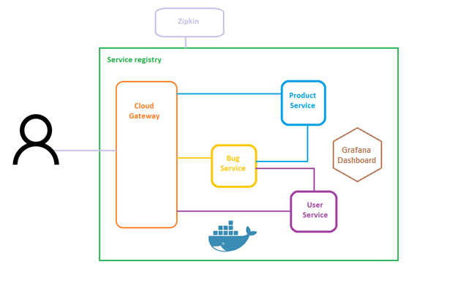
Bug Tracker Microservices Architecture

Slide 3
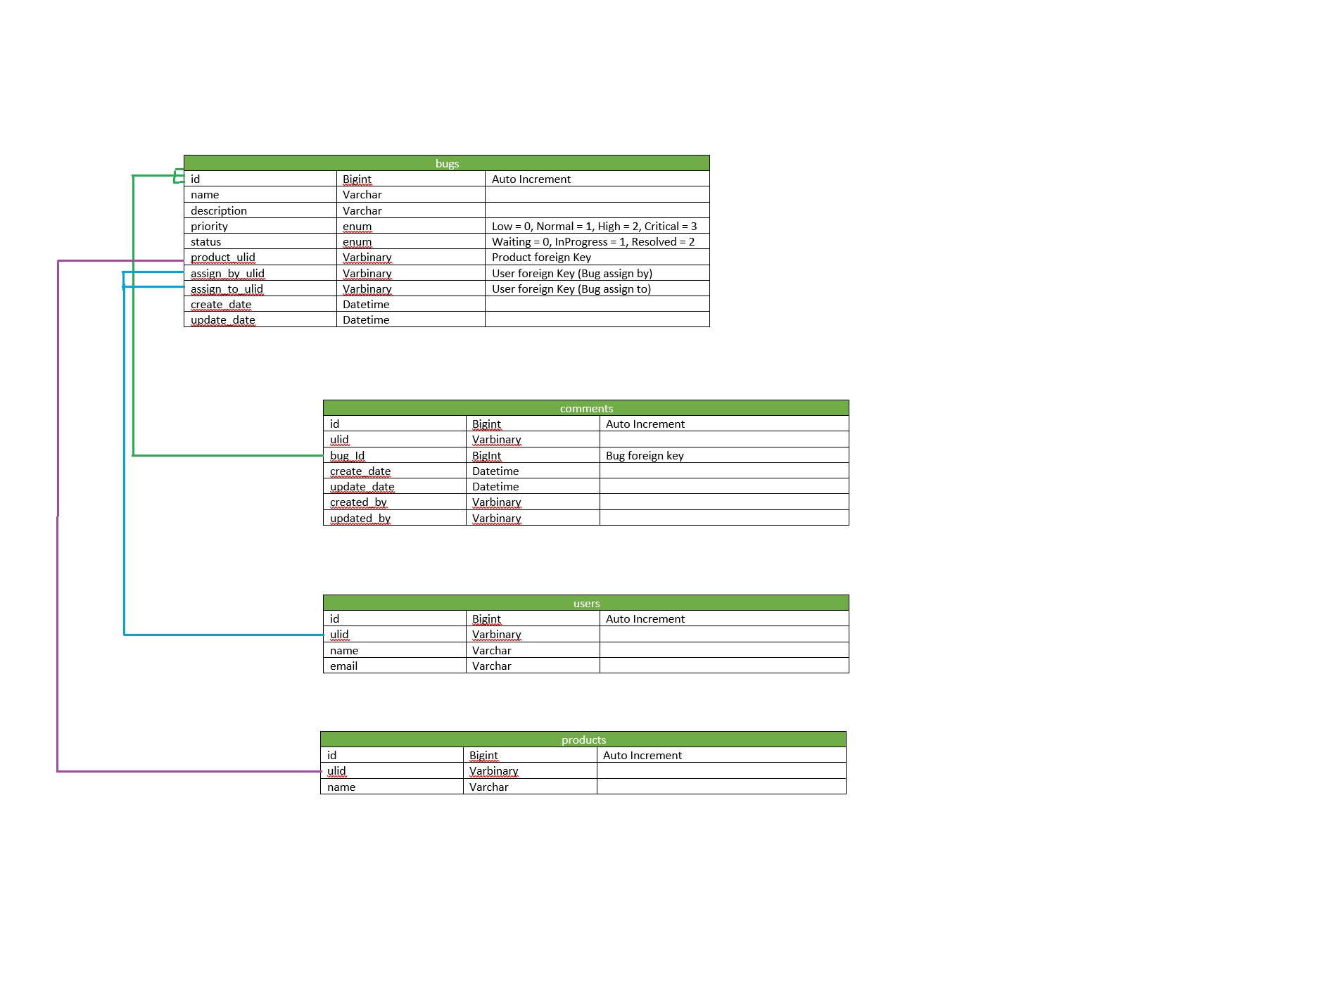
Database Diagram

Slide 4
Service Registry (Eureka Server)
Register all services

Slide 5
Cloud Gateway (API Gateway)
All traffic directs through cloud gateway.
Provide fallback methods for service failing

Slide 6
Bug Service
CRUD operation for Bugs
CRUD operation for Bug’s Comments

Slide 7
Product Service
Fetch product’s information related to bugs

Slide 8
User Service
Fetch user’s information related to bugs

